Slide 1

G2M Case Study
A Comparative Analysis of Pink Cab and Yellow Cab
18th April 2025

Slide 2


Introduction
The cab/taxi market serves as a vital means of mobility. In regulatory challenges and amid various competition, it remains an essential mode of travel/ transport (statista 2024)
This report compares the customer behaviours, financial performance, operational patterns and usage trends of two cab companies, Pink Cab and Yellow Cab.
The actionable insights derived from the analysis aim to guide decision-making, marketing strategies, investment plans and opportunities.

Slide 3

Problem Statement
In the transportation industry, cab companies research and obtain new ways to enhance services, increase customer satisfaction and retention while maintaining a high quality of service, and maximise profits.
Objective:
To compare and analyse the operations of two cab companies, Pink Cab and Yellow Cab, exploring their financial performance, customer demographics, usage and trip patterns to drive growth opportunities and data-backed recommendations

Slide 4
Dataset Description
The dataset consists of information obtained from two cab companies, Pink Cab and Yellow Cab, which are derived from four (4) individual datasets as follows;
Cab_Data.csv – this file includes details of transactions for 2 cab companies
Customer_ID.csv – this is a mapping table that contains a unique identifier which links the customer’s demographic details
Transaction_ID.csv – this is a mapping table that contains transaction to customer mapping and payment mode
City.csv – this file contains a list of US cities, their population and the number of cab users.
Data Sources: Two cab companies' datasets merged into one. Total Records: 440,098 trips/ observations
Final records/ Data Points: 359392
Number of features: 18 (including 3 derived features) Key Features: Date of Travel, City, Age, Gender, Payment_Mode, Income, Distance, Cost of Trip, Profit, Company.
Cab_Data.csv
Customer_ID.csv
Transaction_ID.csv
City.csv
Final data (cleaned_df)

Slide 5
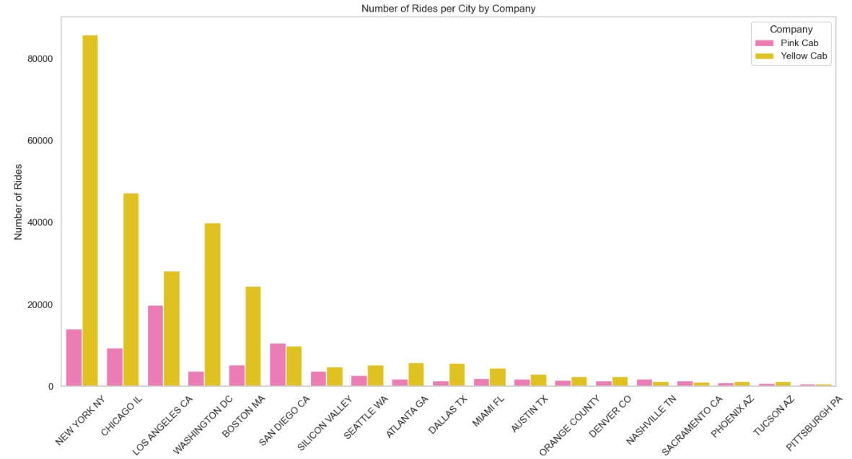
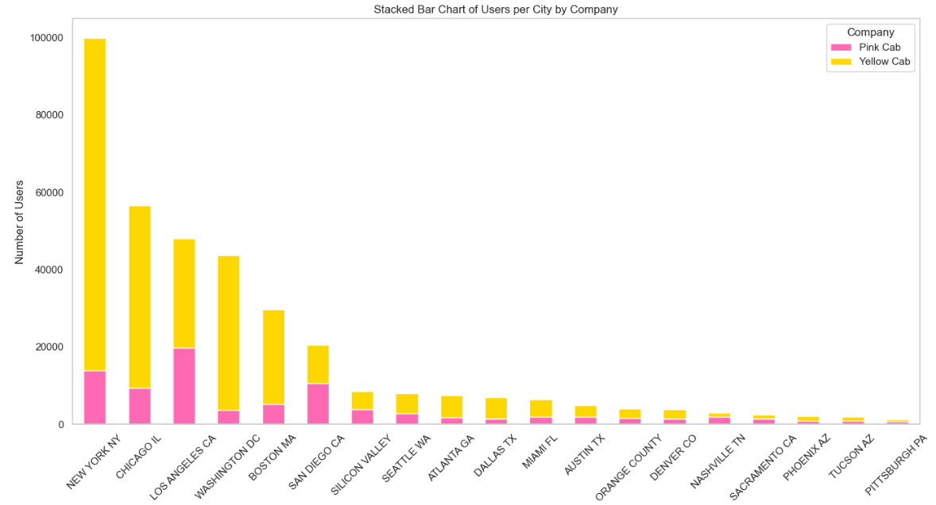

Rides by City
Company Distribution
Insight:
Top 5 cities include New York, Chicago, Los Angeles, Washington DC, and Boston MA.
Yellow Cab dominates in high-density cities.

Slide 6
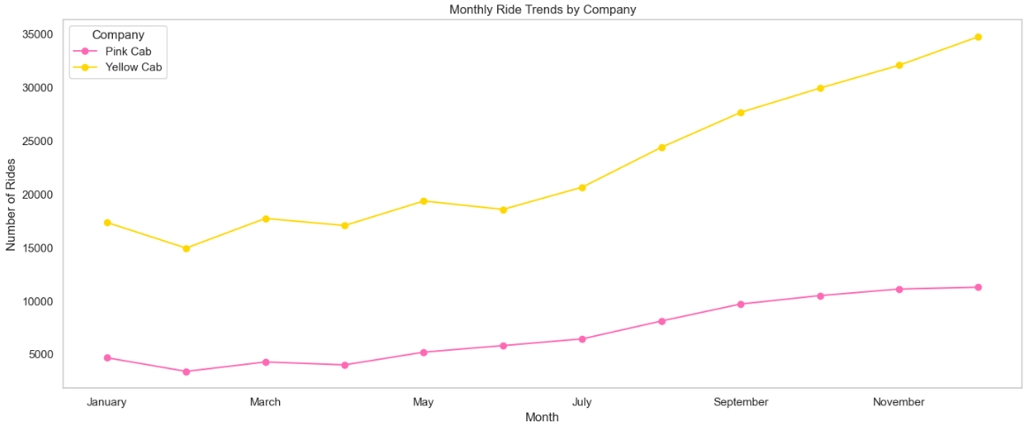
Monthly Ride Trends
Insight:
Yellow Cab has consistently higher ride volume than Pink Cab.
Seasonal trends show demand spikes in specific months (especially holiday months).

Slide 7
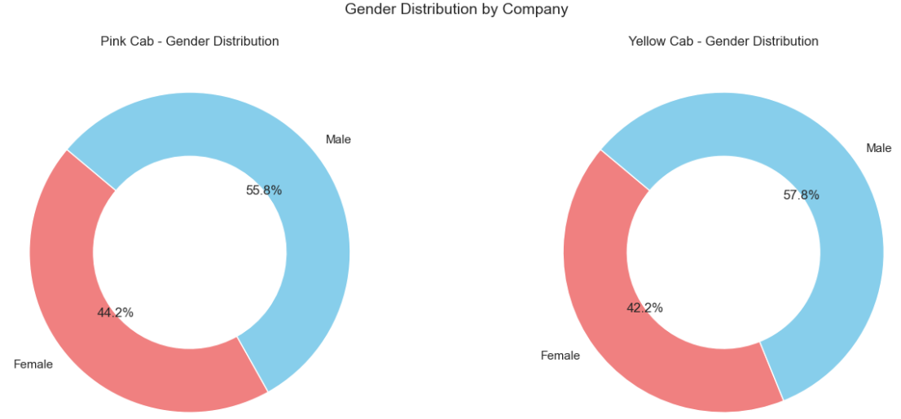
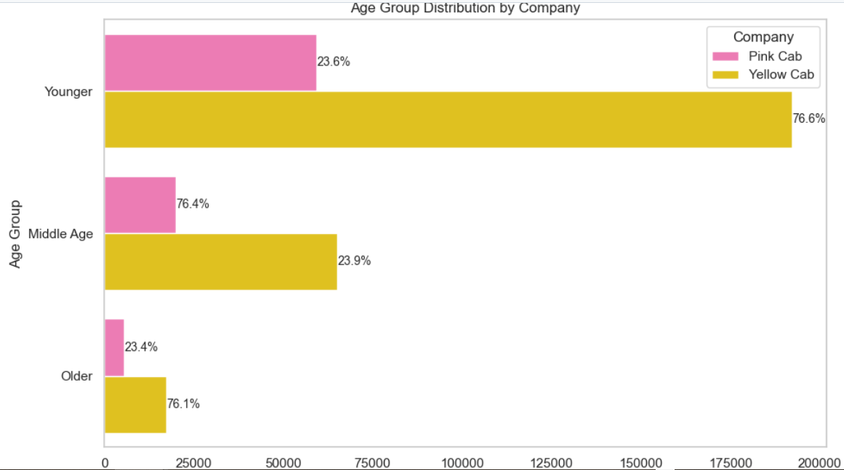
Customer Cab Usage
Insight:
Usage is nearly balanced, but Yellow Cab shows higher male patronage, while the females make a little bit more use of the Pink Cab
Insight:
Young and Middle-aged users form the bulk of cab customers, with the younger age group dominating.
Yellow Cab is preferred across all age groups.
N.B.: 18-39: Younger, 40-59: Middle Age, 60-65: Older

Slide 8
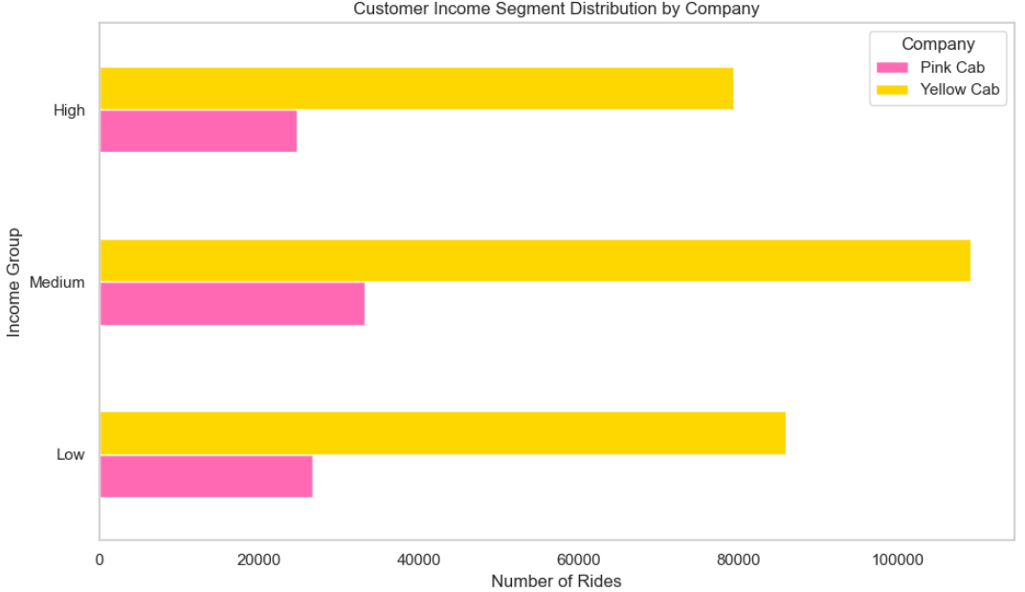
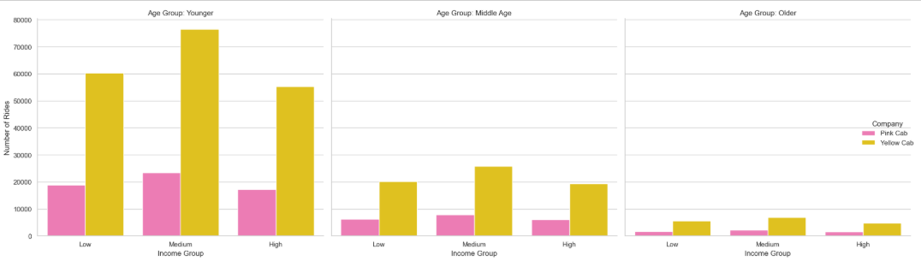
Income Segmentation
Insight:
Yellow Cab appeals more to medium-income customers.
Pink Cab usage is a bit balanced across the high- and low-income levels
. Income patterns show age influences usage.
Younger-aged, medium-income earners dominate Yellow Cab's usage.
N.B.: Income labels: 2000-9999: Low, 10000-19999: Medium, 20000-35000: High

Slide 9
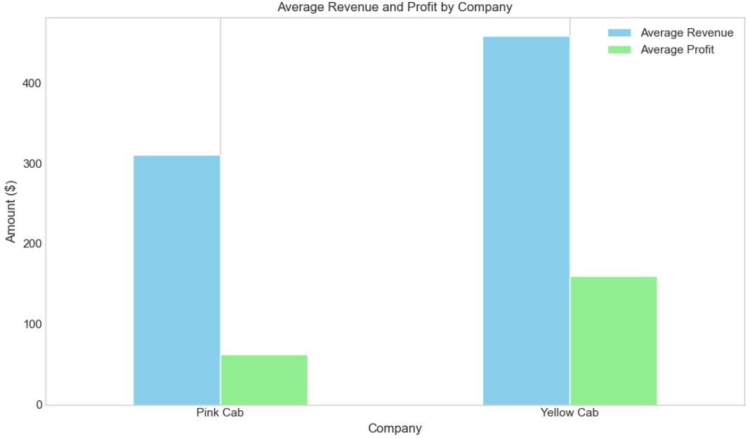
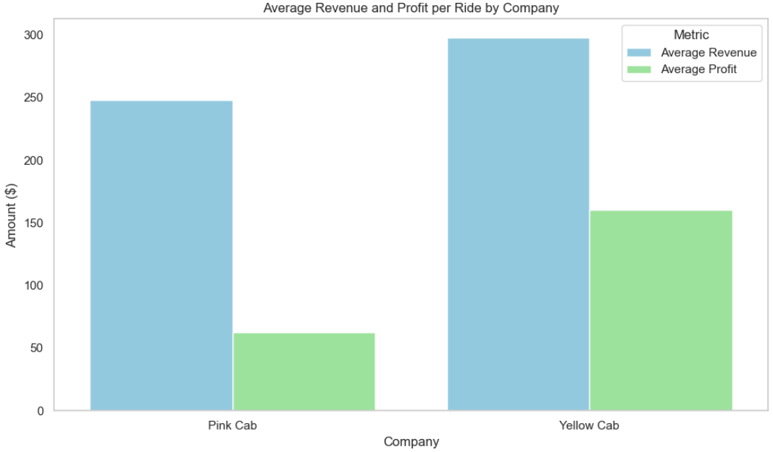

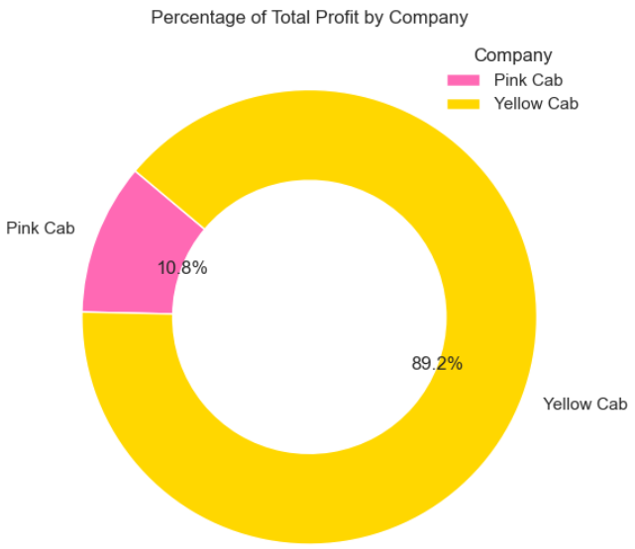
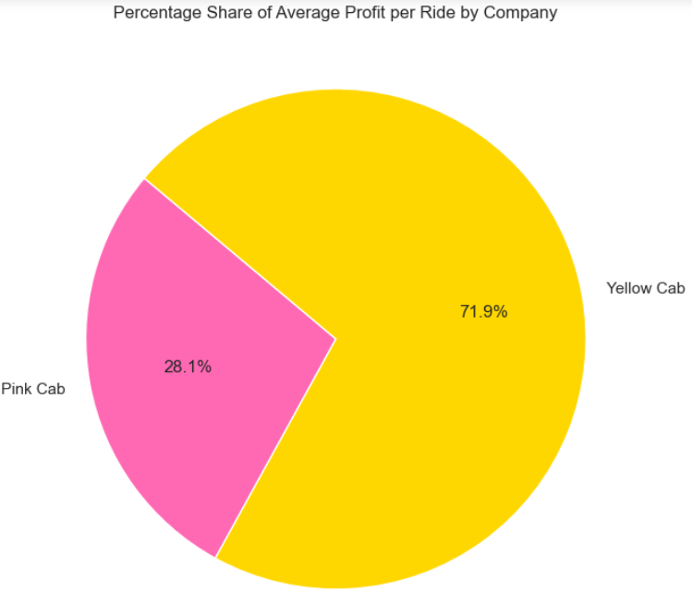
Revenue and Profit Comparison
a)
b)
Insight:
Yellow Cab is the dominant player in revenue and profit, generating higher average revenue and profit.
Pink Cab, although smaller in total figures, might still have areas where it performs well.
N.B.: Average Revenue and Average Profit in terms of
a) price charged
b) cost of trip

Slide 10
Summary of Analysis
Ride Distribution by City & Company
Yellow Cab dominates in ride volume across most cities.
Pink Cab tends to operate in fewer cities with significantly fewer rides.
Monthly Trends
Both companies show fluctuations in monthly ride volumes.
Yellow Cab maintains a consistently higher number of rides, indicating greater market share.
Customer Demographics
Age Group: Young and Middle-Aged customers are the most frequent users.
Gender: Both companies are used by all genders, but there's a slight edge toward male customers overall.
Revenue & Profitability
Yellow Cab earns on average, ~$458M in revenue with ~$160M in profit, while Pink Cab earns an average of ~$310M in revenue and makes ~$62M profit.
Yellow Cab outperforms Pink Cab in terms of revenue and profit by a wide margin.
Customer Segments by Income
Medium-income earners tend to use Yellow Cab more frequently.
Pink Cab serves a broader mix, for both some high and low-income segments penetration

Slide 11
Recommendations
Pink Cab: Explore Expansion Opportunities
Focus on expanding to high-performing cities dominated by Yellow Cab.
Conduct customer satisfaction surveys to understand lower ride volume.
Yellow Cab: Maintain Market Dominance
Continue leveraging cities where performance is high.
Optimise pricing and service quality to retain high-income users.
Personalised Marketing
Segment marketing by age and income group.
Target the “Young” and “Middle Age” categories more directly.
Customer Experience Improvement
Both companies should monitor trends in ride satisfaction across months.
Introduce loyalty or reward schemes to encourage repeat customers.
Customer Loyalty
Introduce reward programs.
Monitor monthly satisfaction trends.

Slide 12
Reference
Market Insights | Statista (2024), Retrieved (16th April 2025). https://www.statista.com/outlook/

Slide 13

Thank You

